Slide 1
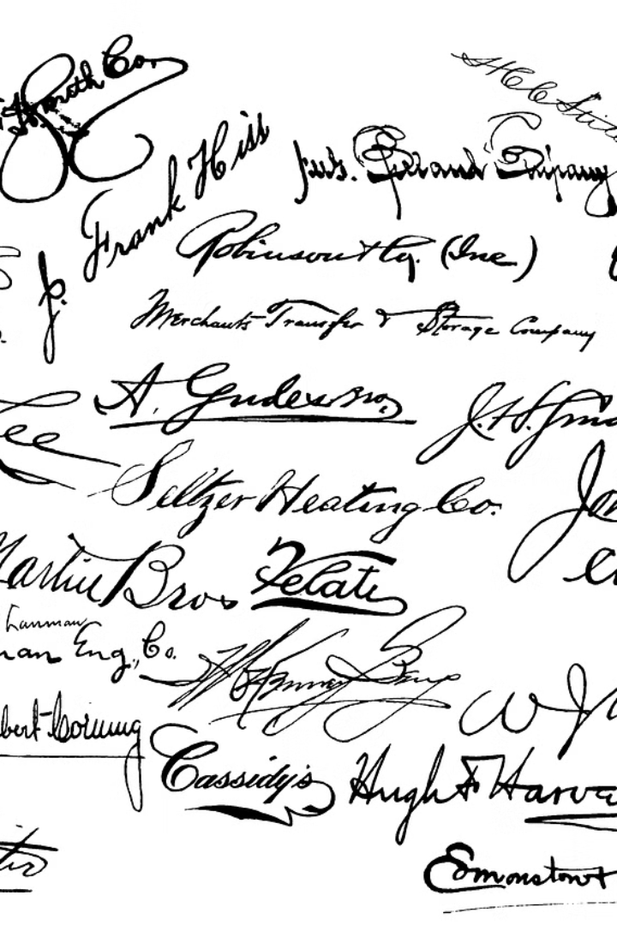
Signature Verification System Using CNN
Project Mentor: Prof. Bhagyashree S. Madan
Team Members:
Anup Dhoble
Suhani Taran
Ankit Bhardwaj
Ajay Mahato
Notes:
‹#›

Slide 2
Problem Of Statement
Create an automated signature verification system using CNNs in Django to combat document forgery. The system aims to streamline authentication processes by accurately classifying handwritten signatures. It seeks to provide a reliable solution for verifying signatures in legal, financial, and commercial transactions.
Signature verification system types:
Writer Independent system (WI): Single model is used to classify a signature.
Writer Dependent system (WD): One model is trained for each user

Slide 3

Motivation
Challenges with Manual Verification:
Time-consuming and error-prone due to subjectivity.
Limits scalability and increases inconsistencies.
Rising Document Forgery:
Increasing prevalence poses significant risks.
Evolving techniques challenge traditional detection methods.
Need for Automated Verification:
Offers streamlined authentication, reducing risks.
Utilizes advanced technologies for enhanced accuracy and efficiency.
Notes:
‹#›

Slide 4
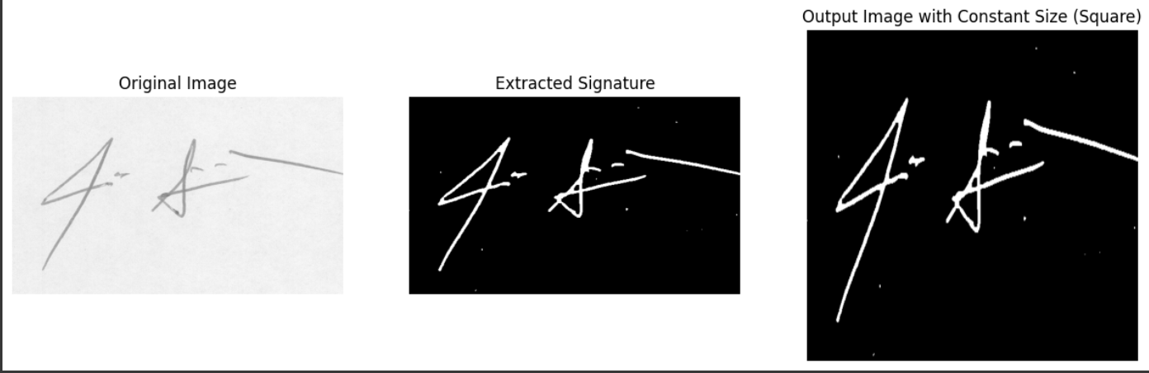
Preprocessing
Grayscale Conversion: Convert the input image to grayscale for simplification and dimensionality reduction.
Gaussian Blur: Apply Gaussian blur to remove noise and smooth out irregularities in the image.
Adaptive Thresholding: Binarize the blurred image using adaptive thresholding to segment the signature from the background.
Morphological Closing: Perform morphological closing to fill small gaps and refine the contours of the signature.
Signature Extraction: Detect contours of the thresholded image and create a mask to extract the signature.
Resizing and Background Addition: Resize the extracted signature to a square shape and add a constant white background.

Slide 5
Model Architecture: ResNet50
Introducing ResNet50:
ResNet50 is a powerful deep learning architecture commonly used in image classification tasks.
It is part of the ResNet (Residual Network) family, known for its ability to train very deep neural networks effectively.
Key Components:
Convolutional Layers:
ResNet50 consists of multiple convolutional layers that extract features from input images.
These layers apply convolutional filters to capture patterns and spatial relationships in the signature images.

Slide 6
Pooling Layers:
Pooling layers reduce the spatial dimensions of feature maps, reducing computational complexity.
Max pooling, a common technique, extracts the most important features from each feature map.
Fully Connected Layers:
Fully connected layers perform classification based on the features extracted by earlier layers.
They learn complex patterns and relationships in the data to make predictions about the authenticity of signatures.
Overall Significance:
With its convolutional, pooling, and fully connected layers, ResNet50 can learn intricate patterns and variations in handwritten signatures.
- This robust feature extraction capability is essential for accurate and reliable signature verification, enhancing document security across various domains.

Slide 7
Model Versions: Overview
Introduction to Model Versions:
Three versions of CNN models were developed for signature verification, each building upon the previous one.
The iterative approach aimed to enhance model performance and robustness over successive versions.
Version 1:
Initial model architecture and training process.
Challenges faced and initial performance metrics.
Version 2:
Improvements made in architecture and training, including data augmentation techniques.
Performance enhancements compared to Version 1 and challenges encountered.
Version 3:
Further enhancements in architecture, training process, and data augmentation.
Achievements in model performance and challenges addressed.

Slide 8
Model Version 1:
Architecture and Training Process:
Version 1 utilized a basic ResNet50 architecture for signature verification.
The model was trained using a predefined loss function, optimizing for accuracy.
Challenges Faced:
Limited Model Complexity: Initial ResNet50 model lacked depth, affecting performance.
Training Fluctuations: High fluctuations in accuracy and loss during training.
Improvements Implemented:
Hyperparameter Tuning: Experimentation to optimize learning rate, batch size, and epochs.
Model Complexity: Addition of convolutional layers to enhance model depth and performance.

Slide 9
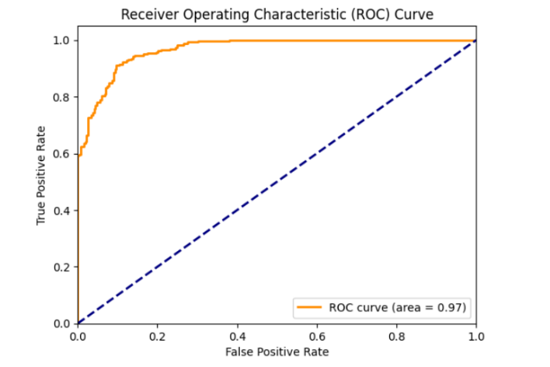
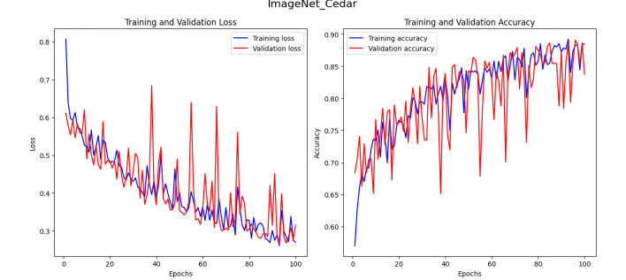
Performance Metrics:
ROC-AUC (Home Dataset): .>90%
Training Accuracy: 86%
Validation Accuracy: 83%
Training Loss: 0.38
Validation Loss: 0.45

Slide 10
Model Version 2:
Architecture and Training Process:
Version 2 retained the base ResNet50 architecture with the addition of data augmentation techniques.
Data augmentation included rotation, shifting, and flipping of signature images to increase dataset variability.
Challenges Faced:
Generalization Issue: Poor performance observed when evaluating on a new dataset (ICDAR2011).
Training Fluctuations: Challenges in stabilizing accuracy and loss during training.
Further Improvements:
Fine-tuning Hyperparameters: Adjustments made to batch size, learning rate, and epoch count.
Continued Optimization: Strategies implemented to address fluctuation issues and improve model stability.

Slide 11
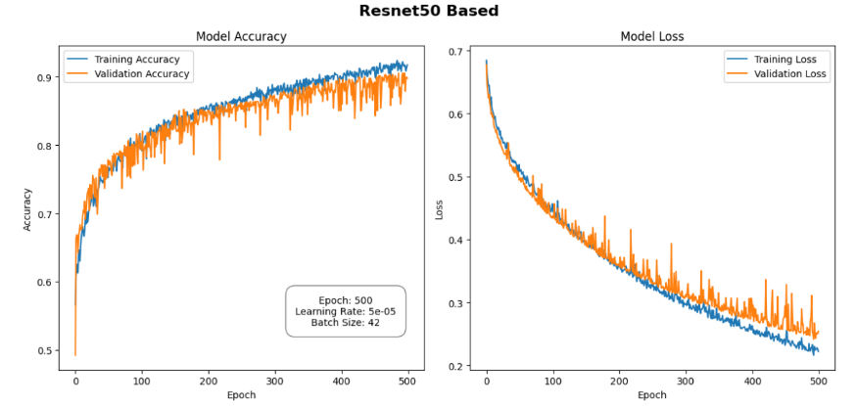
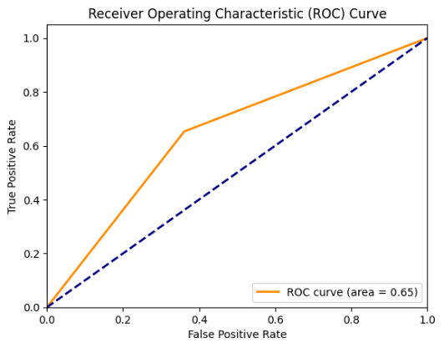
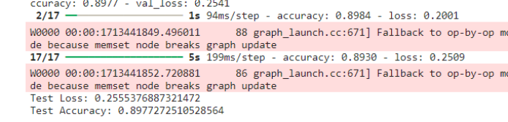
Performance Metrics:
ROC-AUC (Home Dataset): 0.85
ROC-AUC (ICDAR2011 Dataset): 0.65
Training Accuracy: 90%
Validation Accuracy: 89.77%
Training Loss: 0.22
Validation Loss: 0.30

Slide 12
Model Version 3:
Architecture and Training Process:
Version 3 retained the base ResNet50 architecture with further enhancements in data augmentation and hyperparameter tuning.
Extensive data augmentation techniques were employed, including rotation, scaling, and translation, to increase dataset diversity.
Challenges Faced:
Training Time: Increased training time due to augmented data and model complexity.
Generalization: Challenges in ensuring robust generalization to diverse datasets.
Improvements Implemented:
Augmented Data: Leveraging diverse datasets and extensive augmentation to improve model robustness.
Optimized Hyperparameters: Fine-tuning hyperparameters to balance performance and training efficiency.
Enhanced Generalization: Strategies implemented to address challenges in generalization to new datasets.

Slide 13
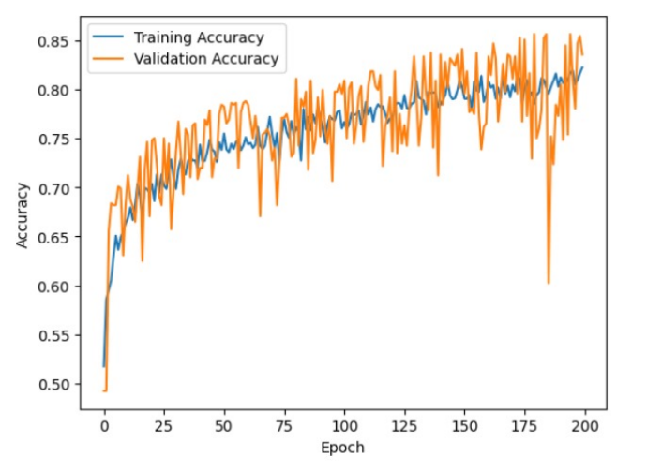
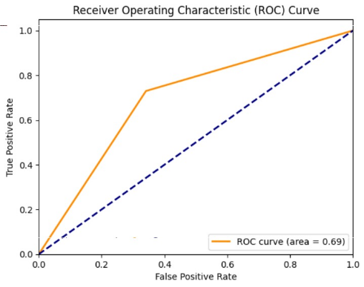
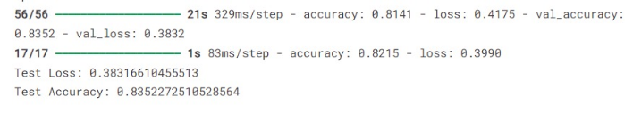
Performance Metrics:
ROC-AUC (Home Dataset): 0.88
Training Accuracy: 92%
Validation Accuracy: 91.23%
Training Loss: 0.18
Validation Loss: 0.25
For Model Version 3 on a Different Dataset:
ROC-AUC (Unseen Dataset): 0.69
False Positive Rate (FPR): 0.341
True Positive Rate (TPR): 0.730

Slide 14
System Implementation
Overview of System Architecture:
Front-end User Interface: Web-based interface for user interaction, including signature upload and result display.
Back-end Server: Computational engine managing user requests, preprocessing data, and orchestrating signature verification.
Integration with CNN Model: Seamless communication between the server and deployed CNN model for inference tasks.
Efficient Integration:
The front-end and back-end components are seamlessly integrated to provide a user-friendly experience.
Communication protocols ensure efficient data transfer between the user interface and computational components.
The CNN model is deployed on the server, enabling real-time signature verification with minimal latency.

Slide 15
Results and Discussion:
Model Training and Evaluation:
The iterative refinement process led to significant enhancements across all model versions, with notable improvements in accuracy and performance metrics observed at each iteration.
Version 3 emerged as the most refined iteration, achieving an outstanding validation accuracy of 91.23% on the validation dataset, indicative of its robust performance.
Implications and Challenges:
The improved accuracy of the models enhances the reliability of signature verification systems in real-world applications.
Challenges such as generalization to diverse datasets and scalability for handling larger volumes of data were addressed to varying degrees in each version.

Slide 16
Future Directions & Conclusion:
Conclusion
Advancements Achieved: Significant progress made in automated signature verification, enhancing model performance and system usability.
Iterative Refinement: Iterative development resulted in a highly accurate and user-friendly signature verification system.
Future Focus: Future efforts will prioritize addressing challenges and optimizing system capabilities for real-world applications.
Continued Innovation: Ongoing innovation will ensure the system's role as a reliable document security solution.
Future Directions
Enhanced Generalization: Improve models' ability to handle diverse signature styles.
Scalability Optimization: Develop strategies to ensure seamless operation under increasing demands.
Advanced Techniques Integration: Incorporate transfer learning and domain adaptation for improved performance.
Usability and Security Enhancements: Focus on user-centric improvements and stringent security measures.

Slide 17
References:
[1] Ruiz-del-Solar, Javier, et al. "Offline signature verification using local interest points and descriptors." Iberoamerican Congress on Pattern Recognition. Springer, Berlin, Heidelberg, 2008.
[2] Chauhan, Prachi, Subhash Chandra, and Sushila Maheshkar. "Static digital signature recognition and verification using neural networks." Information Processing (IICIP), 2016 1st India International Conference on. IEEE, 2016.
[3] Khalajzadeh, Hurieh, Mohammad Mansouri, and Mohammad Teshnehlab. "Persian signature verification using convolutional neural networks." International Journal of Engineering Research and Technology 1 (2012).
[4]Rantzsch, Hannes, Haojin Yang, and Christoph Meinel. "Signature embedding: Writer independent offline signature verification with deep metric learning." International Symposium on Visual Computing. Springer, Cham, 2016.
[5] Hafemann, Luiz G., Robert Sabourin, and Luiz S. Oliveira. "Writer-independent feature learning for offline signature verification using deep convolutional neural networks." Neural Networks (IJCNN), 2016 International Joint Conference on. IEEE, 2016.

Slide 18
THANK YOU

